Slide 1
Compositional Conditional Diffusion Model
For IEEE 10th International Conference on Applied System Innovation
Reporter：Shih-Lun Lai
Date：2024/4/19

Slide 2
CONTENTS
01
02
Introduction
Proposed method
Page 3 ~ Page 10
Page 11 ~ Page 18
03
04
Experiment results
Conclusion
Page 19 ~ Page 24
Page 25 ~ Page 26
Notes:
My report will be divided into four sections. First, I will introduce why we chose this topic and our objectives. Next, I will present the methods we have proposed, followed by showcasing our experimental results. Finally, I’ll conclude our work.

Slide 3
Introduction
PART ONE

Slide 4
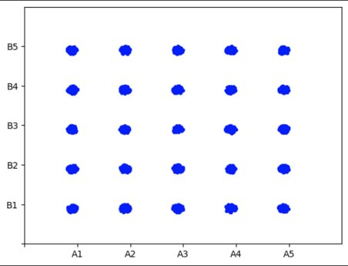
Part1: Introduction
- Motivation work
2D Point Dataset (a toy dataset)
There are total of 24 clusters of points in the following graph.​ How do we generate the set of 25 clusters?
Direct labeling.
Compositional visual generation with energy based models [1] / composable diffusion models [2].
Compositional generation with compositional class label.
v
Notes:
Typically, images generated from a generative model shares the distribution as the training data. Here, we have a 2D point dataset with 24 clusters. We can easily generate those 24 clusters with arbitrary generative models. But how do we generate the missing cluster in the middle, given 24 clusters?
Here are the methods we initially used.
Direct labeling
Compositional visual generation
Compositional generation with compositional class label

Slide 5

Part1: Introduction
- Motivation work
Direct labeling each cluster and generating based on class labels as conditions.
0
1
2
3
4
$$c∈\left\{0, 1, 2, …, 24\right\}$$
5
6
7
8
9
10
11
12
13
14
15
16
17
18
19
Diffusion model
20
21
22
23
24
label 20
v
Notes:
The first method, We labelled each clusters with a class label and trained a class-conditional diffusion model. While testing, clusters will be generated with given class labels.

Slide 6


Part1: Introduction
- Motivation work
Compositional visual generation with energy based models [1] / composable diffusion models [2].
$c_{1}∈\left\{A_{1},A_{2},A_{3},A_{4},A_{5}\right\}$, $c_{2}∈\left\{B_{1},B_{2},B_{3},B_{4},B_{5}\right\}$
Energy model /
Diffusion model
$$c_{1}$$
Compose
Energy model /
Diffusion model
$$c_{2}$$
v
Notes:
The second method we used, is from these 2 papers. The clusters in the same row or column shared a same label. And then we trained a model for each labels. While testing, we use the methods mentioned in these papers to combined the outputs from both models and generate clusters.

Slide 7


























Part1: Introduction
- Motivation work
Compositional generation with compositional class label.
$c=\left\langle c_{1},c_{2}\right\rangle$, $c_{1}∈\left\{A_{1},A_{2},A_{3},A_{4},A_{5}\right\}$, $c_{2}∈\left\{B_{1},B_{2},B_{3},B_{4},B_{5}\right\}$
$$\left\langle A_{1},B_{5}\right\rangle$$
$$\left\langle A_{2},B_{5}\right\rangle$$
$$\left\langle A_{3},B_{5}\right\rangle$$
$$\left\langle A_{4},B_{5}\right\rangle$$
$$\left\langle A_{5},B_{5}\right\rangle$$
$$\left\langle A_{1},B_{4}\right\rangle$$
$$\left\langle A_{2},B_{4}\right\rangle$$
$$\left\langle A_{3},B_{4}\right\rangle$$
$$\left\langle A_{4},B_{4}\right\rangle$$
$$\left\langle A_{5},B_{4}\right\rangle$$
$$\left\langle A_{1},B_{3}\right\rangle$$
$$\left\langle A_{2},B_{3}\right\rangle$$
$$\left\langle A_{3},B_{3}\right\rangle$$
$$\left\langle A_{4},B_{3}\right\rangle$$
$$\left\langle A_{5},B_{3}\right\rangle$$
Diffusion model
$$\left\langle A_{1},B_{2}\right\rangle$$
$$\left\langle A_{2},B_{2}\right\rangle$$
$$\left\langle A_{3},B_{2}\right\rangle$$
$$\left\langle A_{4},B_{2}\right\rangle$$
$$\left\langle A_{5},B_{2}\right\rangle$$
$$\left\langle c_{1},c_{2}\right\rangle$$
$$\left\langle A_{1},B_{1}\right\rangle$$
$$\left\langle A_{2},B_{1}\right\rangle$$
$$\left\langle A_{3},B_{1}\right\rangle$$
$$\left\langle A_{4},B_{1}\right\rangle$$
$$\left\langle A_{5},B_{1}\right\rangle$$
v
Notes:
Finally, here's the method we proposed in our paper. Each cluster is labeled with a compositional class label, which is formed by multiple class labels. These class labels represent different categories. We trained a diffusion model conditioned on these compositional class labels. While testing phase, clusters will be generated with given compositional class labels.

Slide 8
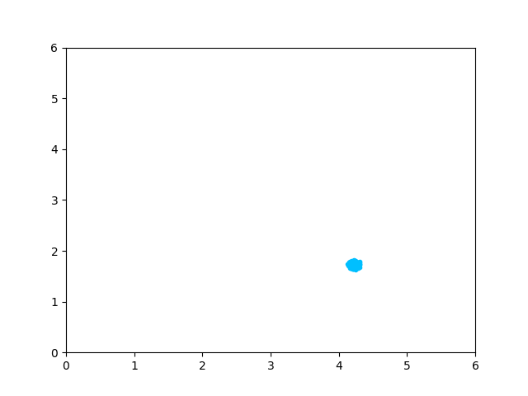
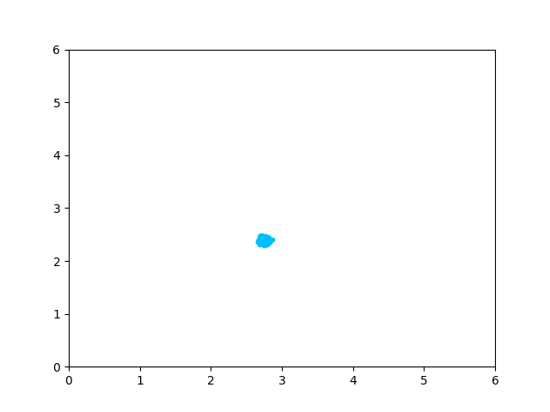
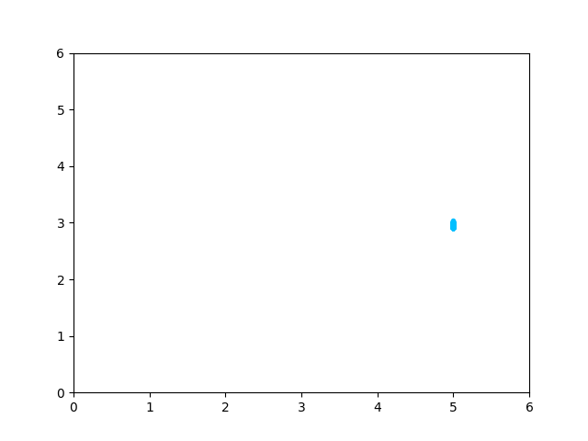
Part1: Introduction - Motivation work (result)
Direct labeling
Energy based model
Composable diffusion model
All shifted !
Notes:
Based on our initial experimental results, the unseen clusters generated by the first three methods are not in the desired locations. They were all shifted.

Slide 9
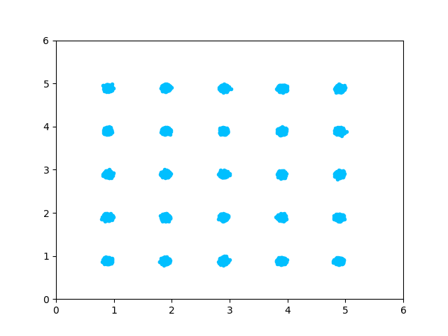
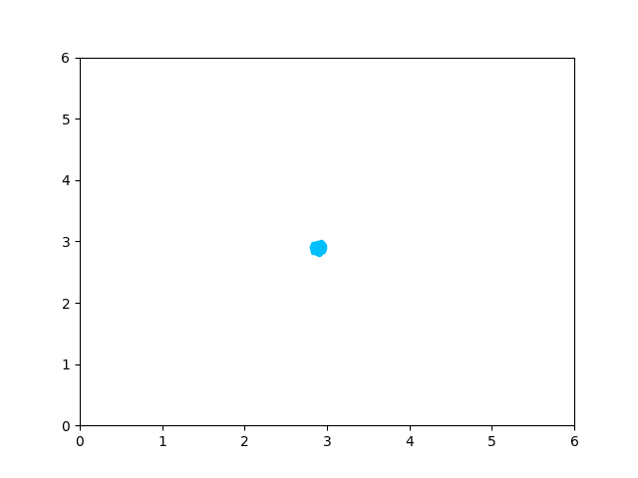
Part1: Introduction - Motivation work (result)
Compositional generation with compositional class label
All clusters
Target cluster
Notes:
On the contrary, our method can correctly generate unseen clusters in the desired locations. With this experimental result, we have gained more confidence in our method.

Slide 10
























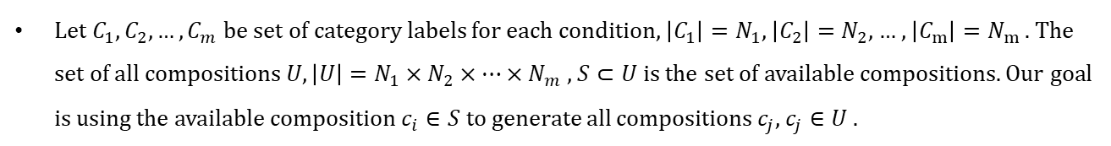
Part1: Introduction
- Goal
Let $C_{1},C_{2}, …, C_{m}$ be set of category labels for each condition, $\left|C_{1}\right|=N_{1}$, $\left|C_{2}\right|=N_{2}$, … , $\left|C_{m}\right|=N_{m}$ . The set of all compositions $U, \left|U\right|=N_{1}×N_{2}×…×N_{m}$ , $S⊂U$ is the set of available compositions. Our goal is using the available composition $c_{i}∈S$ to generate all compositions $c_{j}$, $c_{j}∈U$ .
$C_{1}$ (Animal)
Labels
Dog
Cat
Chicken
Cow
horse
All compositions $U$
Black
White
=
$C_{2}$ (Color)
Red
Available training compositions
Yellow
Missing compositions
Notes:
Consider the example training set here. C1 represents animals types, which has 5 labels, C2 represents their colors, which has 4 labels. Combining these labels will result in a total of 20 compositions , but only 19 of them are present in the training set. We aim to use the existing 19 training compositions to generate all possible compositions. We aim to achieve compositional zero-shot image generation.

Slide 11
Proposed method
PART Three

Slide 12







Part2: Proposed method - Compositional Conditional Diffusion Model (CCDM)
Pixel Space
Condition Space
$$x_{0}$$
Forward diffusion process
$$x_{T}$$
Time
step $t$
Class
lable 1
. . .
Class
lable n
X (T-1)
Compositional
class label $y$
Denoising model $ε_{θ}$
Conditioning module
…
Conditioning module
$$\overline{x_{0}}$$
$$x_{T}$$
Timestep
encoder
Compositional class encoder
Notes:
This is the block diagram of CCDM. In this section, I will introduce the compositional class encoder and the four conditioning modules we implemented in our model.

Slide 13



Part2: Proposed method - Compositional class encoder
Embedding table
One-hot vector
MLP
Class embedding
<$c_{1}, c_{2}$>
Class 1 encoder
One-hot encoding
Class 1 embedding
Addition, Concatenation
Compositional
class embedding $c$
Class 2 encoder
Class 2 embedding
One-hot encoding
Notes:
Compositional class labels are formed by several different types of labels. We first perform one-hot encoding on these labels individually.
Then, we encode the resulting one-hot vectors using an embedding table and an MLP to generate class embeddings.
Finally, these class embeddings are combined through addition or concatenation to produce compositional class embeddings.

Slide 14



Part2: Proposed method - Conditioning Module, method 1 of 4 – Addition (Add) [1]
$$Add\left(h, t, c\right)=h+proj\left(t\right)+proj\left(c\right)$$
ConvBlock2
Hidden state $h$
Compositional class embedding $c$
Timestep embedding $t$
element-wise addition
Notes:
The first conditioning module is Addition, which is referenced form the original DDPM paper. We add up hidden state, compositional class embedding and timestep embedding as the output of this conditioning module.

Slide 15




Part2: Proposed method - Conditioning Module, method 2 of 4 – Adaptive Group Normalization (AdaGN) [2]
$$AdaGN\left(h, t, c\right)=\left(1+c_{s}\right) GroupNorm\left(h\right)+c_{b}$$
Hidden state $h$
GroupNorm
Mul
$$c_{s}$$
ConvBlock2
Projection
Compositional class embedding $c$
Split
$$c_{b}$$
Timestep embedding $t$
element-wise addition
Notes:
The second conditioning module is Adaptive Group Normalization, which is referenced form the Improved DDPM paper. We compute compositional class embedding and timestep embedding first and inject them into the hidden state as the output of this conditioning module.

Slide 16



Part2: Proposed method - Conditioning Module, method 3 of 4 – Image Class Concatenation (IC) (Ours, adapt from [3])
We believe maximally preserves the information
ConvBlock2
Bottleneck layer
Hidden state $h$
C
Compositional class embedding $c$
Timestep embedding $t$
C
channel-wise concatenation
element-wise addition
Notes:
The third conditioning module is Image Class Concatenation. We concatenate informative guidance with intermediate denoised targets in the diffusion process, which we believe maximally preserves the information of compositional class labels.

Slide 17
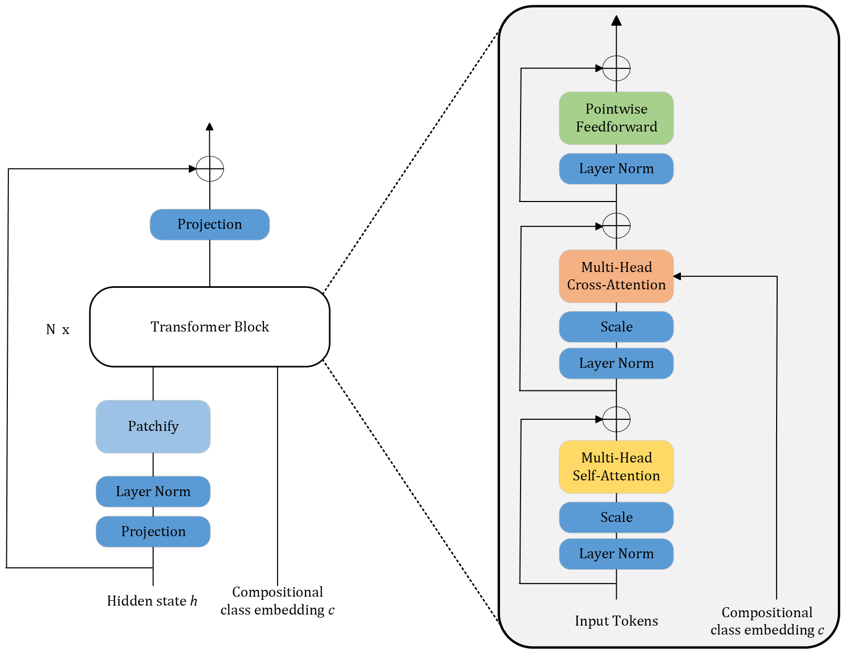
Part2: Proposed method - Conditioning Module, method 4 of 4 – Cross Attention (CA) [4]
ConvBlock2
Shallow
transformer
Hidden state $h$
Compositional class embedding $c$
Timestep embedding $t$
K
V
element-wise addition
Notes:
The last conditioning module is Cross Attention. We use a shallow transformer to combine condition information. We use compositional class embedding as key and value in multi-head cross attention layer in the shallow transformer.

Slide 18
Part2: Proposed method - Image selector on unseen composition
<Attribute, Object>
“Unseen composition”
Sampled images
Drop
CCDM
Match
attribute
Match
object
No
Matching attribute?
Attribute
classifier
Yes
“All match”
Generated image
Intersection
Keep
Matching object?
Object
classifier
Yes
No
Drop
Notes:
Although CCDM has the capability of compositional zero-shot image generation, not every generated image aligns perfectly with the unseen compositional class label. In order to access model performance, we proposed a image selector composed by multiple binary classifiers to filter unseen composition images generated by CCDM.
For example, if the unseen compositional class label is <Red, Cow>, we will train a red binary classifier and a cow binary classifier to determine whether these concepts exist in the images.
We generate a certain number of unseen composition images and utilize the image selector to confirm how many images match the description the unseen compositional class label. Then, we calculate the sampling accuracy.

Slide 19
Experiment results
PART THREE

Slide 20
Part3: Experiment results - CelebFace Attributes Dataset
Two condition setting
 | Condition 1 (Hair color) | Condition 2 (Gender)
Labels | Black hair, Gray hair, Blond hair, Brown hair | Male, Female
Compositions | 4 x 2 = 8
Three condition setting
 | Condition 1 (Hair style) | Condition 2 (Hair color) | Condition 3 (Gender)
Labels | Straight hair, Wavy hair | Black hair, Gray hair, Blond hair, Brown hair | Male, Female
Compositions | 2 x 4 x 2 = 16
Notes:
We use two public datasets to test CCDM. The first one is CelebA. We divide this dataset into two condition settings and three condition settings. Both settings have an unseen compositional class label.

Slide 21


































































































Part3: Experiment results - Experiment (Sampled result on CelebA)
Unseen composition: <Gray hair, Female>
Unseen composition: <Straight hair, Black hair, Male>
<Straight hair, Black hair, Male>
<Gray hair, Female>
<, , Male>
<, , Female>
<Blond hair, Male>
<Wavy hair,
Blond hair, >
<Brown hair,
Male>
<Wavy hair,
Brown hair, >
<Black hair,
Male>
<Wavy hair,
Black hair, >
<Gray hair,
Male>
<Wavy hair,
Gray hair, >
<Blond hair,
Female>
<Straight hair,
Blond hair, >
<Brown hair,
Female>
<Straight hair,
Brown hair, >
<Straight hair,
Gray hair, >
<Black hair,
Female>
Notes:
All of these images are the generated images. The images highlighted in the red boxes are not in the training set. CCDM can generate unseen composition images.

Slide 22
Part3: Experiment results - UT-Zappo50K Dataset
Two condition setting
 | Condition 1 (Shoe height) | Condition 2 (Shoe type)
Labels | Heel, Flat | Boot, Shoe, Sandal, Slipper
Compositions | 2 x 4 = 8
Three condition setting
 | Condition 1 (Filming angle) | Condition 2 (Shoe height) | Condition 3 (Shoe type)
Labels | Left, Right | Heel, Flat | Boot, Shoe, Sandal, Slipper
Compositions | 2 x 2 x 4 = 16
Notes:
For the second experiment dataset, we use UT-Zappo50K dataset, a dataset composed by various shoe types. We split this dataset into two settings as well.

Slide 23


































































































Part3: Experiment results - Experiment (Sampled result on UT-Zappo50K)
Unseen composition: <Heel, Slipper>
Unseen composition: <Left, Heel, Sandal>
<Heel, Slipper>
<Right, , >
<Left, , >
<Left, Heel, Sandal>
<Heel, Boot>
< , Heel, Boot>
<Heel, Shoe>
< , Heel, Shoe>
<Heel, Sandal>
< , Heel, Slipper>
<Flat, Boot>
< , Flat, Boot, >
<Flat, Shoe>
< , Flat, Shoe>
<Flat, Sandal>
< , Flat, Sandal>
<Flat, Slipper>
< , Flat, Slipper>
Notes:
All of these images are the generated images. The images highlighted in the red boxes are not in the training set. Through experiments on these two publicly available datasets, we have confirmed that CCDM is able to do compositional zero-shot image generation.

Slide 24
Part3: Experiment results - Overall architecture comparison
We summarized all quantitative experiments result on every conditioning modules.
Architecture | Sampling accuracy (%)
Add [1] | 33.98
AdaGN [2] | 34.60
IC (Ours, adapted from [3]) | 41.83
CA [3] | 36.33
Notes:
After all experiments)And then we compared the sampling accuracy of the four conditioning modules we used. IC performs the best for compositional zero-shot image generation. This closely meets our expectations // IC performs the best for compositional zero-shot image generation. This closely aligns with our expectations. For the diffusion model with compositional class labels as conditions, element-wise addition in the Add module may aggregate information from multiple class labels, potentially hindering the model's ability to generate correct samples. The same rationale applies to AdaGN. Regarding cross attention (CA), when utilizing compositional class label embeddings as keys and values, it encounters limited dimensions in both keys and values compared to using text as conditions. Combined with the relatively insufficient data, it fails to fully exploit the power of cross attention. Concatenation, on the other hand, maximally preserves the information from compositional class embeddings. Additionally, concatenation avoids mixing the class embeddings of different conditions using addition, making it less prone to confusion for the model.

Slide 25
Conclusion
PART FOUR

Slide 26
Part4: Conclusion
We proposed a diffusion model conditioned on compositional class labels for compositional zero-shot image generation.
Through a series of experimental designs, we demonstrated that our model possesses the capability of compositional zero-shot image generation on toy datasets and public datasets.
Study of human compositional cognitive abilities emphasizes "learning from old compositional concepts and generalizing to new compositional concepts.

Slide 27
References
Denoising Diffusion Probabilistic Models [1]
Improved Denoising Diffusion Probabilistic Models [2]
High-Resolution Image Synthesis with Latent Diffusion Models [3]

Slide 28
Thanks for Your Attention
Reporter：Shih-Lun Lai
Date：2024/04/19

